Slide 1


From Data to Insights A Hands-on Approach
Data Visualization & Analytics using Power BI
4-Days Training Program
Scan to Introduce Yourself!

Slide 2
What is Data Visualization & Analytics?
📊 Data Visualization
- The art of turning raw data into meaningful insights using charts, graphs, and dashboards.
- Helps identify patterns, trends, and outliers at a glance.
- Examples: Bar charts, Line graphs, Heatmaps, Pie charts, and Interactive dashboards.
📈 Data Analytics
- Uses techniques like descriptive, diagnostic, predictive, and prescriptive analytics.
🔑 Why Does It Matter?
- Makes complex data easy to understand
- Improves decision-making with data-driven insights
- Helps identify trends & anomalies quickly
- Supports better forecasting & business growth
- The process of examining data to find trends, relationships, and actionable insights.

Slide 3
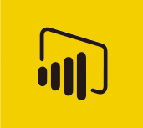
Introduction to Power BI
A complete reporting solution for data preparation, visualization, distribution, and management.
Scales from simple to complex reports with multiple data sources and models.
Enables creation of interactive, visually appealing reports for teams or entire organizations.
Acts as a powerful analytics and decision-making engine.
Essential for data analysts, but valuable for all data professionals to present insights effectively.

Slide 4
Key Components & Workflow
Power BI has three components: Desktop (development), Service (online management), and Mobile (viewing).
Power BI Desktop is used to connect, model, and visualize data.
Reports are published to the Power BI Service for sharing and collaboration.
Power BI Mobile delivers mobile-optimized report views.
Common workflow: Connect → Transform → Visualize → Publish → Distribute.
Dashboards and apps in the Power BI Service help organize and deliver insights effectively.
Power BI Desktop
Power BI Service
Power BI Mobile

Slide 5
Power BI Installation
Open Microsoft Store (Windows 10/11)
Search for "Power BI Desktop"
Click Install (Free)
Or Download from Official Website
Go to: https://powerbi.microsoft.com
Navigate to Products > Power BI Desktop
Click Download Free
Choose language and download the .exe file
Run the Installer
Double-click the downloaded .exe file
Follow on-screen instructions to install
Launch Power BI Desktop
After installation, open the app from the Start menu
Sign in with your work/school Microsoft account if prompted
Download your from - bit.ly/npci_material

Slide 6
Building Blocks of Power BI
Datasets – Collections of data used to build visualizations and reports.
Visualizations – Graphical representations of data, like charts and maps.
Reports – A collection of visualizations assembled on one or more pages.
Dashboards – Single-page, real-time views of key metrics and visuals.
Tiles – Individual visualizations pinned to a dashboard from a report.
Dataflows – Reusable data transformation pipelines within Power BI.
Workspaces – Collaborative environments for developing and managing content.
Apps – Bundled collections of dashboards and reports for distribution.
Visualizations
Reports
Dashboards
Tiles
Datasets
Workspaces
Apps
Dataflows

Slide 7
Power BI Components
Power BI Desktop
Power Query
Power Pivot
Power View
- Perform data transformation
- Store the results in an
excel file or in a Power Pivot model
- Perform data modeling
- Build a schema,
relationships,
- Create user defined fields
- Connect to different data sources
- Create Views
- Add interactivity

Slide 8
Power BI Interface

Slide 9
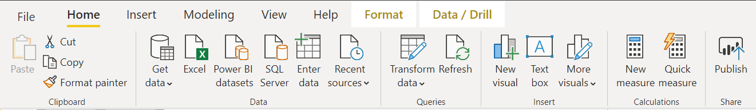
Home Tab - Data Ribbon
Data Connection options
Get Data window, allows to scroll through the list of All data sources

Slide 10
Home Tab - Queries Ribbon
Data Transformation and edit queries
Provides access to Power Query Editor.
It helps shaping data.
Shaping can mean transforming the data, such as renaming columns or tables, removing rows or columns, or changing data types

Slide 11
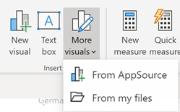
Home Tab - Insert Ribbon
Helps add new visuals
Custom visuals are hosted in AppSource and can be accessed by pressing the “More visuals” dropdown and selecting “From AppSource”

Slide 12
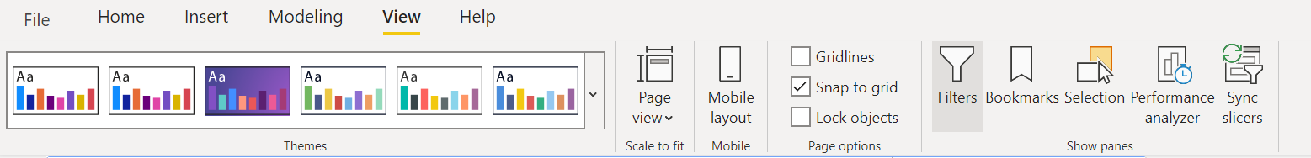
View Tab - Themes Ribbon
Themes ribbon displays themes in a gallery making it more easily to see what colours will be applied to report.
Also allows user to set custom themes

Slide 13
View Tab
Various Page visibility options and hide/show panes on report view tab

Slide 14
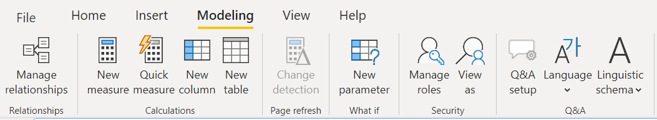
Modelling Tab - Relationships Ribbon
Opens Data Model view
Relationships between tables can be created and managed here.

Slide 15
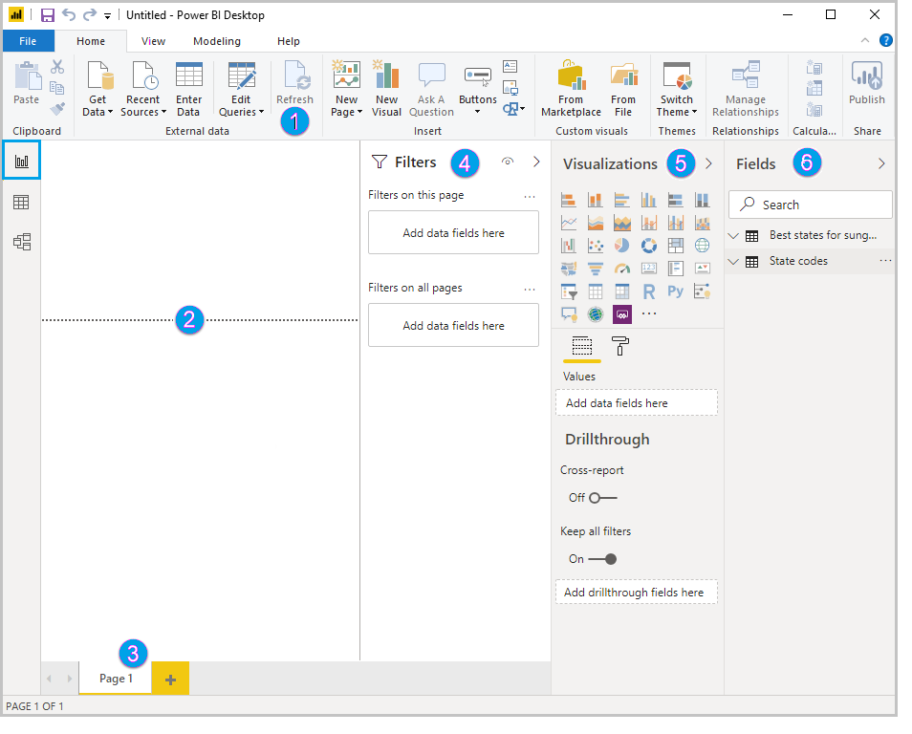
Report View
In Power BI Desktop Report view, user can build visualizations and reports.
The ribbon at the top, which displays common tasks associated with reports and visualizations.
The canvas area in the middle, where visualizations are created and arranged.
The pages tab area at the bottom, which lets you select or add report pages.
The Filters pane, where you can filter data visualizations.
The Visualizations pane, where you can add, change, or customize visualizations, and apply drill through.
The Fields pane, which shows the available fields in your queries. You can drag these fields onto the canvas, the Filters pane, or the Visualizations pane to create or modify visualizations.
1
4
5
6
2
3

Slide 16
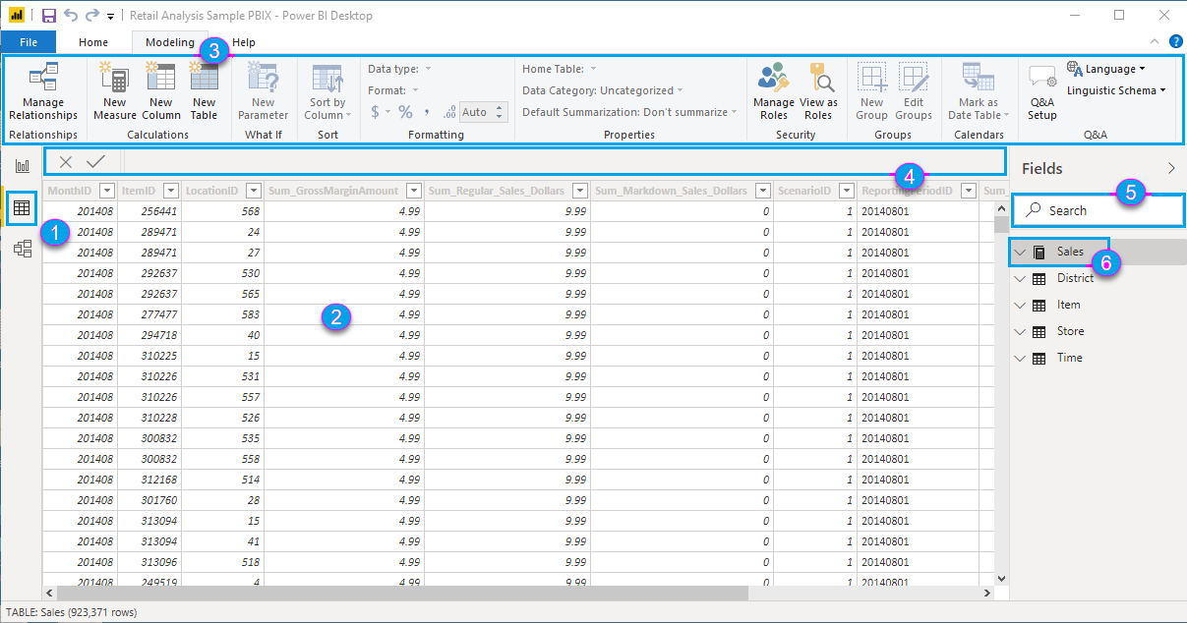
Table View
Data View in Power BI shows a tabular view of your imported data, allowing you to inspect, explore, and verify the dataset before building reports. It helps you see the raw data and understand its structure.
Refer to the figure on the left -
Data view icon - Select this icon to enter Data view.
Data Grid - This area shows the selected table and all columns and rows in it. Columns hidden from Report view are greyed out. Right-click on a column for options.
Modeling ribbon - Tab to manage relationships, create calculations, change data type, format, data category for a column.
Formula bar - Enter Data Analysis Expression (DAX) formulas for Measures and Calculated columns.
Search - Search for a table or column in model.
Fields list - Select a table or column to view in the data grid.

Slide 17
Connecting to Data

Slide 18
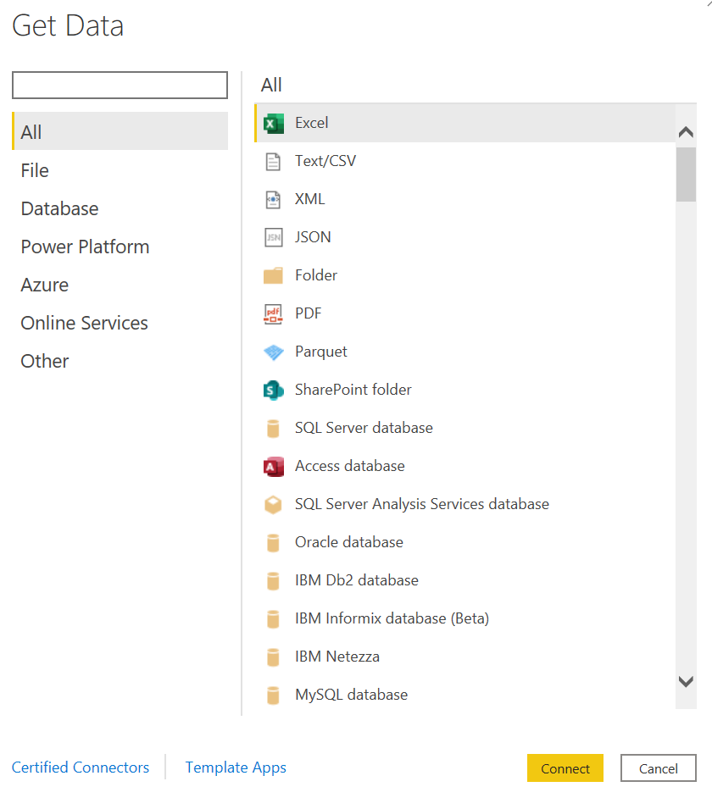
Connect to Data Source
Home Tab > Data Ribbon> Get data
Select the appropriate data connection
Enter credentials (if required)
Load data

Slide 19
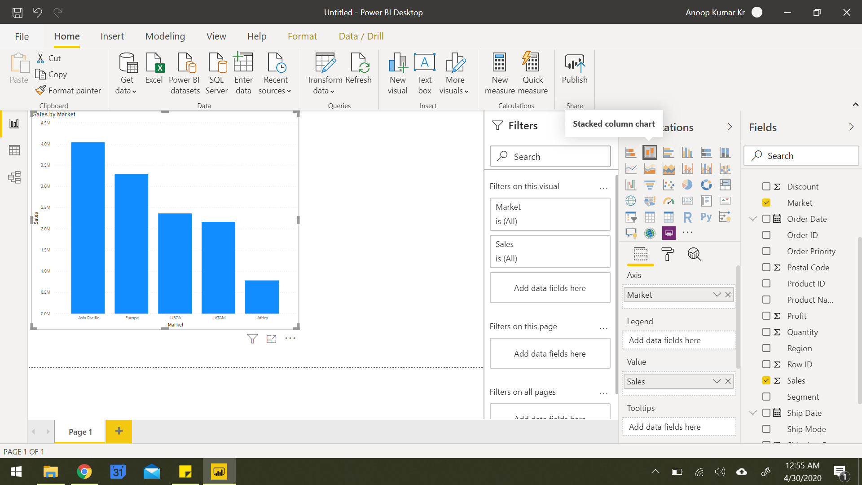
Build a Visualization
1. Understand Your Fields
In the Fields pane (right side), review your tables and columns.
Identify dimensions (categories like “Department”) and measures (quantities like “Sales” or “Salary”).
2. Choose Your Visualization
In Report View (center canvas):
Go to the Visualizations pane.
Click on a chart type (e.g., bar, line, pie, table, etc.).
A blank chart will appear on the canvas.

Slide 20
Build a Visualization
3. Drag and Drop Fields
Drag fields from the Fields pane to the appropriate areas in the Visualizations pane:
Axis / Legend / Category: For dimensions (e.g., Month, Department).
Values: For numerical data (e.g., Sales, Quantity).
Filters / Tooltips: For filtering or showing additional data on hover.
4. Format Your Chart
Use the Format tab (paint roller icon):
Adjust titles, colors, labels, gridlines, data labels, etc.
Toggle on/off legends, tooltips, and other elements.

Slide 21
Connect to file Employees.xlsx file
Load data from Employee sheet
Create Visualizations:
Card Chart: Total number of Employees
Bar Chart:. Average Salary by Department.
Line Chart: Number of employees joined per year.
Pie Chart: Employee count by department
Scatter Chart: Correlation between Age and Salary
Slicer: Gender
Demo - Customizing theme, formatting visuals, formatting pages, drill up/down filters, edit interactions

Slide 22
Power BI Filters: What We’ve Learned So Far –
Cross-Filtering / Cross-Highlighting – Occurs when selecting a data point in one visual filters or highlights data in another.
Edit Interactions – A feature that lets you control how one visual affects others when selected (filter, highlight, or do nothing).
Found under the Format > Edit Interactions toolbar option.
Slicers – Interactive on-page filters users can click to filter multiple visuals at once.
Drill through Filters – Allow users to right-click a data point and navigate to a detail page with context carried over.
Visual-Level Filters – Apply to a single visual only. Other visuals are unaffected.
Page-Level Filters – Affect all visuals on the current report page.
Report-Level Filters – Apply across all report pages, useful for global filters like region or time period.

Slide 23
Power BI Styling Tools: What We’ve Learned So Far –
Customizing Theme
Themes control colors, fonts, backgrounds, and default styles for all visuals.
Access via: View > Themes
Formatting Visuals
Each visual can be individually styled using the Format pane.
Common options include:
Title: Text, size, alignment, and font.
Data labels: Show values on charts.
Legend: Show/hide, position, font, color.
Colors: Change bar/line/segment colors.
Tooltips: Customize hover-over info.
Borders & Backgrounds: Add emphasis or group visuals visually

Slide 24
Power BI Styling Tools: What We’ve Learned So Far –
Formatting Pages
Customize the layout and behavior of entire report pages.
Found under the Format > Page information or by clicking the empty canvas:
Page size: Switch between default, 16:9, letter, or custom dimensions.
Backgrounds: Add colors or images to the canvas (e.g., branded templates).
Canvas settings: Enable gridlines or snap-to-grid for visual alignment.

Slide 25
Introduction to Power Query Editor

Slide 26
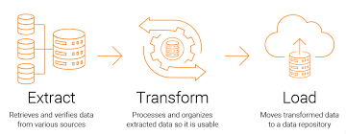
Overview of Power Query Editor
Tool for connecting, transforming, and shaping data.
Available in Power BI, Excel, and other Microsoft tools.
Generates M code automatically based on actions.
Interface split into Query Pane, Data Preview, and Applied Steps.
Data Source Connectivity
Connect to multiple sources: Excel, CSV, SQL Server, Web, APIs, SharePoint, etc.
Combine multiple queries using merge or append.
Use parameters and functions for dynamic data loads

Slide 27
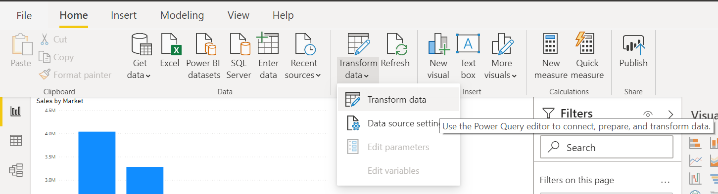
Launch Power Query Editor
Home Tab > Queries Ribbon > Transform data

Slide 28
Data Transformation Tools
Definition - Data transformation is the process of converting data from its raw form into a structured, usable format by applying operations like cleaning, reshaping, and enriching.
Purpose - It ensures data is consistent, accurate, and ready for analysis or reporting by correcting errors, standardizing formats, and structuring datasets.
Types of Transformations - Includes filtering, sorting, aggregating, splitting or merging columns, changing data types, and removing duplicates.
Use Case - Data Cleaning -
Fixing missing or incorrect values, removing duplicates, and standardizing formats to improve data quality.
Use Case - Data Integration -
Combining data from multiple sources (e.g., databases, spreadsheets) into a unified dataset for comprehensive analysis.
Use Case - Preparing Data for Visualization -
Transforming data to fit the needs of charts and dashboards, such as grouping or pivoting data for better insights.

Slide 29
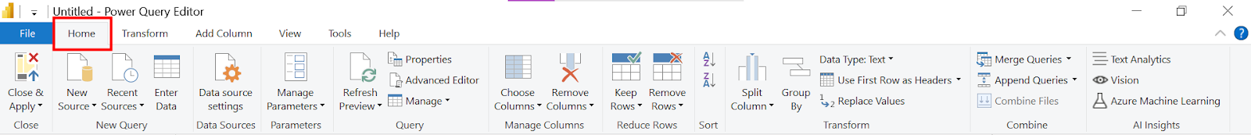
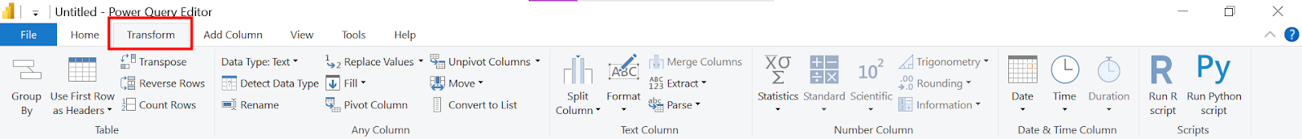
Power Query Editor – Interface
Home Tab - essential commands for data import, transformation, and query management.
Transform Tab - Contains tools to modify and clean your data, like changing data types, filtering, and splitting columns.

Slide 30
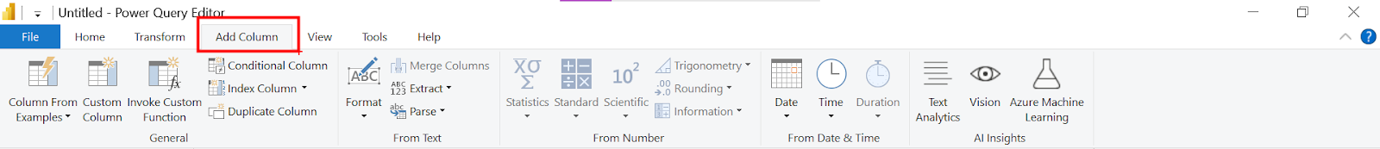
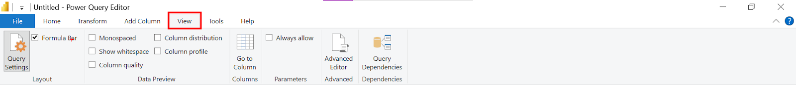
Power Query Editor – Interface
Add Column Tab - Allows you to create new columns based on calculations, conditions, or custom formulas.
View Tab - Offers options to manage the Power Query interface, such as viewing query dependencies, formula bar, and layout settings.

Slide 31
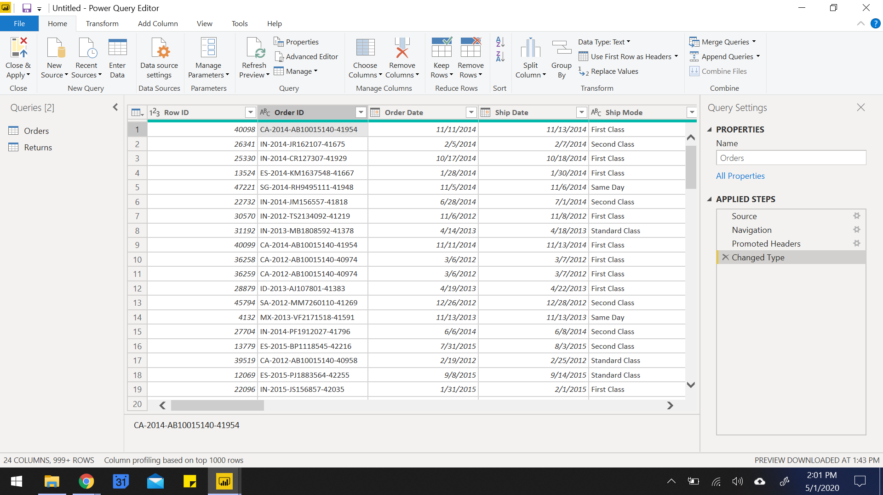
Power Query Editor – Interface
List of queries
Data preview of the selected sheet gets loaded

Slide 32
Power Query Editor – Interface
Renaming query
List of all the transformation steps applied on the data

Slide 33
Example : Use Employee dataset –
Apply Power Query transformation –
View column profile, Employment Age calculation(check for any descripency), Create age groups(conditional column)
Example : Use GDP dataset –
Connect to file Country GDP by Year.csv
Convert to unpivot the columns to analyze GDP over the years.

Slide 34
Common Transformations in Power Query
Transformation | Description
First Row as Headers | Promotes the first row to be column headers.
Remove Columns | Delete unnecessary columns to clean the dataset.
Change Data Type | Convert columns to appropriate data types (e.g., date, number, text).
Split Column | Break a column by delimiter (e.g., comma, space) or number of characters.
Merge Columns | Combine two or more columns into a single column with a separator.
Trim/Clean Text | Remove extra spaces or non-printable characters from text data.
Fill Up/Down | Fill null values using values from above or below rows.
Replace Values | Substitute specific values with new ones (e.g., fix typos, unify names).
Transformation | Description
Date Transformation | Extract year, month, day, quarter, or calculate durations from date columns.
Text Transformation | Change case (upper/lower/proper), extract substrings, or format strings.
Add Conditional Column | Create logic-based columns (e.g., "High" if Sales > 500, else "Low").
Add Custom Column | Write simple formulas using M to create new fields.
Group By | Aggregate data (sum, average, count) by categories or IDs.
Column Profiling | View data quality, column distribution, and value statistics.
Transpose Table | Swap rows and columns for better alignment or reshaping data.
Unpivot Columns | Convert wide-format data to long format for analysis.

Slide 35
Combining Tables with Append Queries
What is Append?
Appends = Stack rows from one or more tables into a single table.
When to Use It:
Combining monthly files, regional sales reports, or similar structured tables.
All tables should have matching columns (same names and order preferred).
How to Do It:
Go to Home > Append Queries (or "Append Queries as New").
Select the two or more tables you want to combine.
Result: One long table with all rows stacked.
⚠️ Tip: Columns that don’t match may create nulls or extra columns.

Slide 36
Combining Tables with Merge Queries
What is Merge?
Merges = Join data from two tables using a common key (like VLOOKUP).
When to Use It:
Adding customer info to orders.
Joining product master with sales data.
Enriching data from reference tables.
How to Do It:
Go to Home > Merge Queries (or "Merge Queries as New").
Select the two tables and matching columns (keys).
Choose Join Type:
Left Join (default): All rows from the first table, matched from the second.
Inner Join: Only matching rows from both.
Full Outer, Right Outer, Anti Joins, etc.
⚠️ Tip: After merging, click the expand icon (🔽) to select which columns to add from the second table.

Slide 37
Example: Use Stock Data for following examples –
Append data from all the 3 companies into a single table
Ex. Create a chart to see the monthly change in volumes of stocks, beginning of 2010 to the end of 2014. Which two consecutive months saw the least fluctuation in increase or decrease?
Ex. Compare avg open value for all the companies across 2010 to 2014. Which company saw a drop in value in 2013? Which month of 2013 for that company was the lowest value? Was this all time low or lowest for that year?
Ex. Create a table chart showing the sum of Volume per Company per Year. What was the total volume for Apple in 2013 and the total volume for Apple for 2010 through 2014, respectively?

Slide 38
Example : Invoice Dataset –
Connect to invoice.xlsx file and import all tables
Merge invoice and products tables
Examples –
Ex. How many invoice are generated?
Ex. How many vendors are associated with us?
Ex. How many products are present?
Ex. Calculate total Sales amount by adding a column
Ex. Filter out the unpaid invoices

Slide 39
Merge vs Append in Power Query
Feature | Merge | Append
Purpose | Combine tables side-by-side using a key | Stack tables on top of each other
Structure | Tables may have different columns | Tables should have same columns/structure
Use Case | Lookups, enrich with customer/product data | Combine monthly, regional, or similar data sets
Action | Joins based on a common field (e.g., ID) | Adds rows from one table to another
Example | Add Customer Name to Order Data | Combine Jan, Feb, Mar sales tables
⚠️ Tip: Think of Merge as a VLOOKUP (horizontal) and Append as stacking files (vertical)

Slide 40
Data Tab

Slide 41
Data Tab
View Imported Data: The Data tab allows you to see the underlying dataset in a tabular format after it's loaded into Power BI.
Inspect and Validate: Users can verify data values, check for missing or incorrect data, and ensure data quality before using it in visuals.
Create Measures and Columns: You can write DAX formulas to create new measures, calculated columns, and quick measures directly from the Data tab.
Field Properties: Modify field names, data types, formatting, and data categories (like geographic fields or dates).
Preview Only – Not Editable: The Data tab doesn’t allow data editing (like Excel), but reflects all transformations done in Power Query.

Slide 42
Data Tab - Toolkit
Create and Edit DAX Calculations – Build measures, calculated columns, and calculated tables using DAX.
Format Fields – Change data type, decimal places, date/time format, currency symbols, etc.
Rename and Reorder Columns – Easily rename fields and adjust their display order in the Fields pane.
View Table Data – Explore and inspect loaded data row by row in tabular format.
Hide/Unhide Fields – Choose which fields to show or hide in the report view.
Sort Data by Column – Define custom sorting (e.g., sort Month Name by Month Number).
Define Hierarchies – Create hierarchies like Year > Quarter > Month for better drill-down visuals.
Set Data Categories – Tag columns as Geography, Web URL, Image URL, etc., for appropriate visual treatment.

Slide 43
Example – Use Invoices Dataset
Ex. Format ‘Net Sales’ as currency - Change the data type to Currency and set the symbol (₹, $, etc.) for clearer financial reporting.
Ex. Rename columns for clarity – For instance, change "No of Units" to "Quantity Sold" or "Invoice #" to "Invoice Number.
Ex. Categorize vendors or products – Create a simple column to classify vendors (e.g., Local vs. International) or products by type.

Slide 44
DAX Expressions

Slide 45
Introduction to DAX
DAX stands for Data Analysis Expressions.
It is a formula expression language used in Analysis Services, Power BI Desktop, and Power Pivot in Excel.
DAX formulas include functions, operators, and values to perform advanced calculations and queries on data in related tables and columns in tabular data models.
DAX calculation formulas are used in measures, calculated columns, calculated tables, and row filters.
By using Data Analysis Expressions (DAX), you can add three types of calculations to your semantic model:
Calculated tables
Calculated columns
Measures

Slide 46
DAX Data Types
Common Data Types:
Whole Number → 64-bit integer
Decimal Number → 64-bit real (up to 17 digits)
Boolean → TRUE/FALSE
Text → Unicode string
Date → Jan 1, 1900
Currency → High-precision numeric (±9.22×10¹⁴ with 4 decimal places)
BLANK Type:
Represents NULL or empty cell.
Not the same as zero.
Use BLANK() to return BLANK, ISBLANK() to check it.

Slide 47
DAX Operators
Arithmetic Operators: Perform basic mathematical calculations.
+ (Addition)
- (Subtraction)
* (Multiplication)
/ (Division)
^ (Exponent
Logical Operators: Combine expressions to test for multiple conditions. Return TRUE or FALSE.
&& (AND) - TRUE if both expressions are TRUE.
|| (OR) - TRUE if either expression is TRUE.
IN - TRUE if a value exists within a list of values.
Comparison Operators: Compare two values. The result is a logical value (TRUE or FALSE).
= (Equal to)
> (Greater than)
< (Less than)
>= (Greater than or equal to)
<= (Less than or equal to)
<> (Not equal to)
Text Concatenation Operator:
Joins two or more text strings into a single string.
& (Ampersand)

Slide 48
DAX Variables
Variables in DAX allow you to store the result of an expression, which can then be referenced multiple times within a single DAX formula.
This can improve readability, performance, and reduce redundancy.
Returning the Result: After declaring one or more variables, you must use the RETURN keyword to specify the result of the DAX formula, which can be one of the declared variables or an expression that uses the variables.
Scope of Variables: Variables have scope only within the DAX formula in which they are declared. They cannot be accessed from other formulas.
Benefits of Using Variables:
Improved Readability: Variables make complex formulas easier to understand by breaking them down into smaller, named parts.
Enhanced Performance: When an expression is assigned to a variable, it's evaluated only once, even if the variable is used multiple times in the formula. This can lead to performance improvements, especially for computationally intensive expressions.
Reduced Redundancy: Avoid repeating the same expression multiple times within a formula by assigning it to a variable.
Declaring Variables: Variables are declared using the VAR keyword, followed by the variable name, an equals sign (=), and the expression to be assigned to the variable.

Slide 49
DAX Functions
DAX Function | Meaning / Purpose | Example
SUM | Adds all the numbers in a column | SUM(Sales[Amount])
AVERAGE | Returns the average of all the numbers in a column | AVERAGE(Sales[Profit])
MIN | Returns the smallest numeric value in a column | MIN(Products[Price])
MAX | Returns the largest numeric value in a column | MAX(Products[Price])
COUNT | Counts the number of rows in a column that are not blank | COUNT(Orders[OrderID])
COUNTA | Counts the number of values (non-empty) in a column | COUNTA(Customers[Name])
COUNTROWS | Counts the number of rows in a table | COUNTROWS(Sales)
DISTINCTCOUNT | Counts the number of distinct (unique) values in a column | DISTINCTCOUNT(Orders[CustomerID])
CALCULATE | Evaluates an expression in a modified filter context | CALCULATE(SUM(Sales[Amount]), Region[Name] = "West")

Slide 50
DAX Functions
DAX Function | Meaning / Purpose | Example
FILTER | Returns a table that represents a subset of another table | FILTER(Sales, Sales[Amount] > 1000)
ALL | Removes filters from a column or table | CALCULATE(SUM(Sales[Amount]), ALL(Sales))
RELATED | Returns a related value from another table using a relationship | RELATED(Product[Category])
IF | Returns one value if a condition is TRUE, otherwise another | IF(Sales[Amount] > 500, "High", "Low")
SWITCH | Evaluates an expression against a list of values and returns result | SWITCH([Rating], 1, "Poor", 5, "Excellent", "Average")
AND | Returns TRUE if both conditions are true | IF(AND(Sales[Amount] > 500, Sales[Quantity] > 5), "Valid", "Invalid")
OR | Returns TRUE if either condition is true | IF(OR(Sales[Amount] > 500, Sales[Quantity] > 5), "Valid", "Invalid")
NOT | Returns the opposite of a logical value | IF(NOT(Sales[Amount] > 500), "Low", "High")
FORMAT | Formats a value according to a specified format string | FORMAT(Sales[Date], "MMMM YYYY")

Slide 51
DAX Functions
DAX Function | Meaning / Purpose | Example
DIVIDE | Performs division and handles divide-by-zero errors | DIVIDE(Sales[Amount], Sales[Quantity], 0)
VALUES | Returns a one-column table that contains the distinct values from a column | VALUES(Customers[City])
RANKX | Returns the rank of an item in a list, with optional sorting order | RANKX(ALL(Sales[Product]), [Total Sales], , DESC)
ISBLANK | Checks whether a value is blank | IF(ISBLANK(Sales[Discount]), "No Discount", Sales[Discount])
SELECTEDVALUE | Returns the value when a single value is selected, otherwise returns alternate result | SELECTEDVALUE(Products[Category], "All Categories")
NOW | Returns the current date and time | NOW()
Refer for more DAX functions - https://learn.microsoft.com/en-us/dax/dax-function-reference

Slide 52
Measures
Measures are dynamic calculation formulas where the results change depending on context
A formula in a measure can use standard aggregation functions automatically created by using the Auto sum feature, such as COUNT or SUM, or can be defined by the user using the DAX formula bar
Named measures can be passed as an argument to other measures.
The syntax for a measure includes the measure's name preceding the formula

Slide 53
Calculated Columns
A calculated column added to an existing table and then assigned a DAX formula that defines the column's values
Since a calculated column is created in a table in the data model, it is not supported in models that retrieve data exclusively from a relational data source using DirectQuery mode
When a calculated column contains a valid DAX formula, values are calculated for each row as soon as the formula is entered
Values are then stored in the in-memory data model

Slide 54
Difference between Calculated Column and Measure
Feature | Calculated Column | Measure
Definition | Creates a new column in a table using DAX | Calculates a value based on context using DAX
Storage | Physically stored in the data model | Calculated on the fly when used in visuals
Context | Row-by-row (row context) | Filters, slicers, and visuals (filter/context aware)
Use Case | Derive values per row, like Profit = Sales - Cost | Aggregate values, like Total Sales = SUM(Sales)
Performance Impact | Can increase model size if overused | More efficient and optimized for large datasets
Where used | Appears as a column — can be used in slicers, tables, etc. | Appears in values area — used in KPIs, visuals, etc.
Example | Sales[Profit] = Sales[Revenue] - Sales[Cost] | TotalRevenue = SUM(Sales[Revenue])
⚠️ Tip: Use Calculated Columns when you need to create new fields per row. Use Measures for aggregations and summarizations in visuals.

Slide 55
Example – Use Invoices Dataset
Ex. Visualise the total sales across all products. Which product generate highest revenue? – (Cluster column chart)
Ex. Compute the net sales amount after applying an 18% tax rate to the total revenue. (Create Measure, table chart)
Ex. Transform net sales values into a more readable financial format by converting them into lacs or crores, as appropriate for regional reporting standards. (Create Measure, table chart)
Ex. Identify and count all invoices where the payment was received after the due date(30 days from invoice date), indicating delayed transactions. (Create Column, table chart)
Ex. What is the average delay between invoice date and payment date? – (card chart)
Ex. Visualize the distribution of payment delays using a histogram to analyze the frequency of different delay durations.
Ex. Determine the month-over-month percentage change in net sales to assess sales performance trends over time. – (table chart and icons)

Slide 56
Date Table
Date tables in Power BI are tables that only contain date-related data.
It is a standard dimension table that can be used to reference dates in your model and analyze data based on these dates.
They are also useful for time intelligence calculations and when creating reports that require precise date information.
Date tables allow you to slice and dice your data by date attributes such as weekday, month, quarter, and year.
They also allow you to use DAX time intelligence functions that can be used to generate Fiscal year calculations
A date table is a table that meets the following requirements:
It must have a column of data type date (or date/time)—known as the date column.
The date column must contain unique values.
The date column must not contain BLANKs.
The date column must not have any missing dates.
The date column must span full years. A year isn't necessarily a calendar year (January-December).
The date table must be marked as a date table.

Slide 57
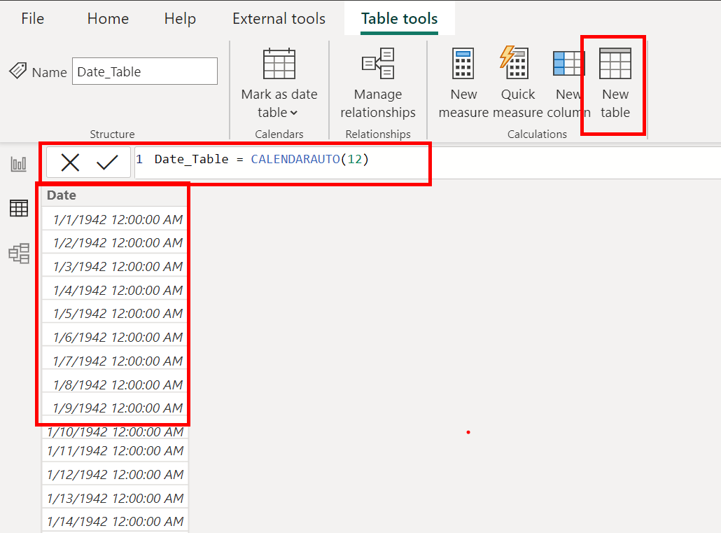
Click on New Table in Data Tab
Use function calendarauto()
It will generate a range of dates
Example – Use Invoices Dataset
Ex. Create a dedicated Date table for time-based analysis
Ex. Creating Date Table, adding FY year | month | quarter
Ex. Create hierarchy of the newly created columns
Ex. Visualise net sales performance over months across financial year? – sort by month#

Slide 58
CALENDAR vs. CALENDARAUTO
Feature / Aspect | CALENDAR | CALENDARAUTO
Purpose | Creates a date range between specified dates | Creates a date table based on dates present in model data
Syntax | CALENDAR(start_date, end_date) | CALENDARAUTO([fiscal_year_end_month])
Input Required | Start and end dates must be manually defined | No input needed (optional fiscal month)
Date Range Control | Full manual control | Automatically determined by data in the model
Dynamic with Data | No — static unless updated manually | Yes — automatically adjusts as data changes
Fiscal Year Support | No | Yes — can define fiscal year end month
Best For | Custom or fixed date ranges | Dynamic models with unknown or varying date ranges
Potential Pitfall | May miss dates if not updated properly | May include unexpected dates if junk/extra dates exist in data
Data Dependency | Independent of model data | Dependent on date fields in the model
Common Use Case | Time-intelligence with a defined calendar range | Quick start with auto-generated calendar across entire model

Slide 59
Row – Context vs Filter – Context
Filter Context
Comes from report filters, slicers, and visual-level filters.
Tells DAX: “Calculate this measure, but only for the selected dimension.”
Used primarily in measures.
Ex. Total Sales = SUM(Sales[Amount]) - This measure will calculate differently based on the filters applied in visuals.🔷
Row Context
Comes from iterators like SUMX, FILTER, ADDColumns, or a calculated column.
Tells DAX: “Evaluate this expression for each row in this table.”
Used primarily in calculated columns and iterators.
Ex. In a calculated column - SalesTax = Sales[Amount] * 0.05 - This happens row by row — each row’s amount gets multiplied.

Slide 60
Data Modelling

Slide 61
Example : Global Superstore Dataset –
Connect to orders file using folder option
Connect to global superstore.xlsx and import all tables
Merge orders and returns tables
Model the remaining table using relationship
Examples –
Ex. How many customers are registered to our portal?
Ex. How many orders were placed?
Ex. How many products delivered?
Ex. How many orders were placed with only 1 product?
Ex. How many customers have never placed a single order?

Slide 62

Introduction to Data Modelling
Data Modelling in Power BI is the process of connecting, organizing, and structuring data from multiple sources using relationships, calculated fields, and hierarchies to enable efficient analysis and reporting. It helps create a logical view of data that supports meaningful visualizations and insights.
A good data model offers the following benefits:
Data exploration is faster.
Aggregations are simpler to build.
Reports are more accurate.
Writing reports takes less time.
Reports are easier to maintain in the future.

Slide 63
Key-Characteristics of Data Model
Relationships: Power BI uses relationships to connect tables, allowing users to create reports across multiple data sources without duplicating data.
Star Schema: It's best practice to model data using a star schema — fact tables at the center surrounded by dimension tables — to improve performance and clarity.
Primary and Foreign Keys: Relationships are defined using primary and foreign keys; ensure each dimension table has a unique key to maintain data integrity.
Cardinality and Cross Filter Direction: Define relationship cardinality (one-to-one, one-to-many, many-to-one) and choose appropriate filter directions (single or both) to control data flow.
Calculated Columns and Measures: Use DAX to create calculated columns and measures for custom aggregations and KPIs directly within the model.
Data Types and Formatting: Ensure that data types are correctly set (e.g., date, number, text) to avoid issues during analysis and visualizations.
Hierarchies: Create hierarchies (e.g., Year > Quarter > Month) in your model to enable intuitive drill-downs in visuals.
Performance Optimization: Reduce the size and complexity of your model by removing unnecessary columns, using numeric keys, and aggregating data when possible.

Slide 64
Data Granularity
Definition: Data granularity refers to the level of detail stored in your dataset — higher granularity means more detailed data.
Importance: Impacts report performance, usability, and how data is analysed or visualized.
Example Use Case: IoT data from trucks may log temperatures every few minutes. Instead of importing all records, a daily average can reduce load and enhance performance.
Granularity Options: Can be set to minute, hourly, daily, weekly, monthly, or quarterly levels depending on user needs.
Trade-off: Lower granularity = faster performance; Higher granularity = better drill-down. Must balance detail vs. speed.
Relationships Impact: Tables must have matching granularity to create relationships (e.g., Sales by Day vs. Budget by Month).
Fixing Mismatched Granularity: Use Power Query to create custom columns (like "YYYY-MM") to align table formats for relationship creation.
Best Practice: Agree on granularity level with stakeholders early to ensure accurate, efficient, and usable reports.

Slide 65
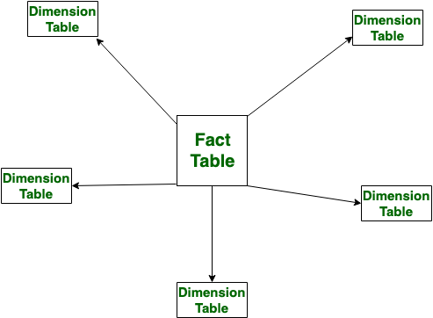
Star Schemas
Definition: Star schema is a data modeling design where a central fact table is connected to multiple dimension tables in a star-like layout.
Fact Table: It contains measurable, quantitative data (e.g., sales, revenue, quantity) and foreign keys linking to dimension tables.
Dimension Tables: These hold descriptive attributes (e.g., Product Name, Customer, Region) that provide context to the facts.
Simplified Queries: Star schema enables simpler and faster queries due to clear relationships and fewer joins.
Improved Performance: As fewer joins are required compared to snowflake schema, performance is optimized in Power BI reports.
Supports Hierarchies: Star schema allows creation of hierarchies (like Year > Quarter > Month) within dimensions for better drill-down in reports.

Slide 66
Relationship vs Merge in Power BI
Feature | Relationship (Power BI Model) | Merge (Power Query Editor)
Definition | Logical connection between two tables in the data model | Joins two tables together into a single query
Where it's used | In Power BI Data Model (after loading data) | In Power Query Editor (before loading data)
Based on | Key columns (e.g., CustomerID) | Key columns, similar to SQL JOINs
Result | Keeps tables separate but allows cross-table analysis | Returns a new combined table or adds columns to a query
Type | One-to-one, one-to-many, many-to-one | Left Join, Inner Join, Right Join, Full Outer, Anti Join, etc.
Impact on reports | Used in DAX, visuals, filters, and slicers | Transforms and reshapes raw data before it's modeled
When to use | When tables are related and used independently in reports | When you want to enrich or flatten data into one query
⚠️ Tip: Use Relationships for dynamic filtering & calculations across tables. Use Merge when you want to combine data into one table before modelling.

Slide 67
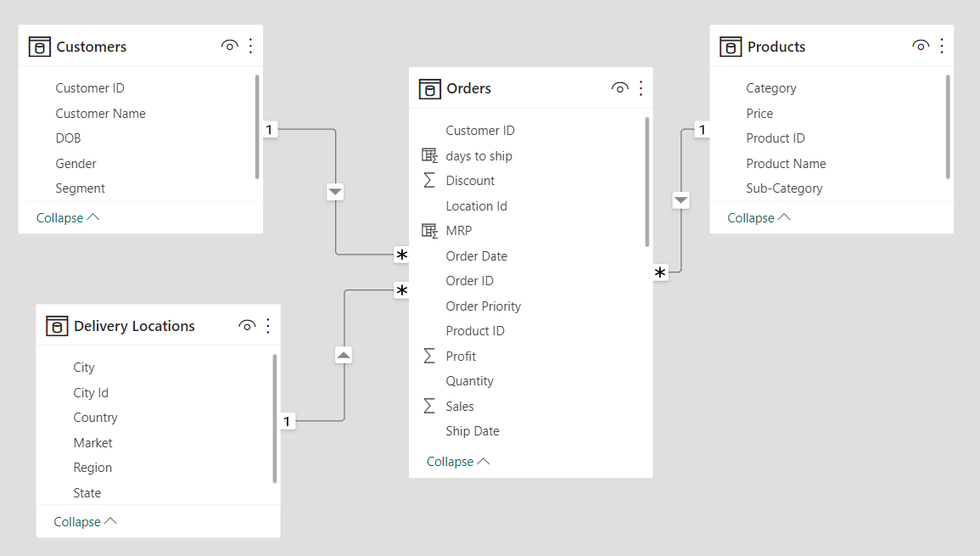
Examples using Global Superstore Dataset –
Ex. Which Market received maximum orders?
Ex. Which month – year showed the lowest Profit?
Ex. Find product subcategory which has negative profit in all the segment with the help of bar chart?
Ex. How many products were returned? What are the total shipping expenses on returned products?
Build a data model using Global Superstore Dataset
as in the diagram below –

Slide 68
Managing relationships
Automatic Detection: Power BI often auto-detects relationships based on matching column names and data types.
Types of Relationships:
Many to one (*:1): The column in one table can have more than one instance of a value, and the other related table, often known as the lookup table, has only one instance of a value
One to one (1:1): The column in one table has only one instance of a particular value, and the other related table has only one instance of a particular value
One to many (1:*): The column in one table has only one instance of a particular value, and the other related table can have more than one instance of a value
Many to many (*:*): Removes requirements for unique values in tables while using composite models
Active vs. Inactive:
Only one active relationship between two tables is allowed at a time.
Inactive relationships can be activated in DAX using USERELATIONSHIP().

Slide 69
Visualize data in Power BI

Slide 70
Power BI Report View
What is Report View?
The Report View is the main design workspace in Power BI Desktop where you create and arrange your visualizations (charts, tables, maps, etc.).
It appears as the middle icon (a bar chart symbol) in the left vertical pane.
Here you build the interactive report pages seen by end users.
Key Components on Report View:
Canvas: The large white area where visuals are placed and arranged.
Visualizations Pane: Contains all chart types and visual elements you can add.
Fields Pane: Shows tables and fields from your dataset, drag to add to visuals.
Filters Pane: To apply filters at visual, page, or report level.

Slide 71
Adding and Customizing Visualizations
How to add visuals:
Click any visualization icon (e.g., clustered bar chart, pie chart, line chart) in the Visualizations pane.
The visual placeholder appears on the canvas.
Drag fields from the Fields pane into the appropriate visual fields (e.g., Axis, Legend, Values).
Customizing visuals:
Use the Format pane (paint roller icon) to change colors, fonts, labels, titles, background, borders, and more.
Example: Change the bar colors to match corporate branding or add data labels for clarity.
Resize and reposition visuals by dragging edges or moving them on the canvas.

Slide 72
Using Filters and Slicers
Filters Pane:
Apply Visual-level filters to restrict data for a single visual.
Use Page-level filters to affect all visuals on the current page.
Use Report-level filters to apply across all report pages.
Slicers:
Add slicers from the Visualizations pane to create interactive filters users can manipulate.
Example: Add a slicer on "Year" so users can dynamically select the year to view.
Customize slicer style (dropdown, list, between values) in the Format pane.
Best Practice:
Use filters and slicers thoughtfully to give users control without overwhelming the report.

Slide 73
Conditional Formatting
What is Conditional Formatting?
Conditional formatting highlights data in tables, matrices, and charts based on defined rules or dynamic logic, improving data interpretation.
Where Can You Apply It?
Tables & Matrices
Background color
Font color
Data bars
Icons
Charts
Color of bars/lines based on value or rules
Saturation levels in maps or scatter plots
How to Apply It
Select the visual (table, matrix, chart).
Go to the Format pane → Expand the field (e.g., "Values").
Choose Conditional formatting → Select "By rules", "Color scale", or "Field value".
Use Cases
Highlight top/bottom performers
Color-code based on thresholds or KPIs
Visually represent trends or outliers
Improve dashboard readability
Benefits
Enhances visual storytelling
Quickly draws attention to important insights
Customizable for user-specific logic

Slide 74
Bookmarks and Navigation for Interactive Reports
Bookmarks:
Bookmarks capture the current state of the report page — including filters, slicers, and visual settings.
Use bookmarks to create report stories, snapshots, or toggle views.
Example: Save a bookmark showing "Top 10 customers" or "Current month sales."
Buttons and Images for Navigation:
Insert Buttons (Home, Back, Reset, etc.) or Images via the Insert menu.
Assign Bookmark actions or Page navigation actions to these buttons/images.
This enables users to jump between views or pages smoothly, making the report more interactive.
Example:
Create a "Home" button that returns users to the main dashboard page.

Slide 75
Better User Experience
Keep navigation intuitive and consistent
Use clearly labeled buttons (e.g., “Home”, “Back”) and maintain their position across pages.
Use tooltips and button text to guide users
Enable tooltips for visuals and navigation elements to help users understand purpose without clutter.
Combine bookmarks and buttons
Create interactive reports where users can toggle views (e.g., show/hide visuals or switch between summaries and details).
Avoid clutter – less is more
Show only essential visuals on a page. Use bookmarks or drillthroughs to display more when needed.
Group and align visuals properly
Use the alignment tools to maintain visual consistency and a professional layout.
Use slicers for key filters
Empower users with slicers for commonly changed filters like date, region, or product category.
Use themes and color schemes wisely
Apply consistent color palettes (match brand guidelines) to improve readability and aesthetics.
Add a 'Reset Filters' or 'Clear Selection' button
Use bookmarks to return all slicers and filters to their default state, making exploration easier.

Slide 76
Enhancing User Experience with Visual Elements
Using Images and Shapes:
Insert logos, icons, or shapes to brand your report and improve aesthetics.
Images can also act as clickable buttons with assigned actions.
Custom Buttons: Create custom navigation buttons and assign actions like:
Bookmark: Show/hide visuals or toggle filters.
Page Navigation: Move to other report pages.
Web URL: Link to external websites or documents.

Slide 77
AI Features in Power BI
1. Smart Narrative (Narrative Visuals)
Auto-generates text summaries for visuals or entire reports
Useful for automated insights, highlighting trends, key drivers, and anomalies
2. Q&A Visual
Allows users to ask natural language questions (e.g., "total sales by region")
Power BI interprets the query and generates visuals accordingly
Auto-suggests valid field names and values for better usability
3. Decomposition Tree
Breaks down metrics (like Sales) by multiple dimensions
Automatically surfaces key contributors to a value
Includes AI-driven "High Value" and "Low Value" options
4. Key Influencers Visual
Uses ML to identify what factors impact a given metric
Great for understanding drivers behind outcomes (e.g., what affects customer satisfaction)

Slide 78
Power BI Report Design & Interaction Tips
Organize Measures Using a Dummy Table & Display Folders
Create a dummy (empty) table specifically to store all your DAX measures. This improves model clarity and helps you manage calculations. Then, use Display Folders in the Model view to group and organize these measures logically (e.g., KPIs, Ratios, YoY comparisons).
Use Report Page as a Tooltip for Enhanced Interactivity
Create a dedicated report page with visuals, set its Page Information → Page Type to Tooltip, and then assign it as a tooltip on other visuals. This allows users to hover and see contextual insights (e.g., order-level breakdowns).
Precisely Align & Distribute Visuals
Use Format > Align and Distribute tools to cleanly align objects on the canvas. It improves the visual consistency and readability of your reports.
Quickly Analyze Trends (Increase/Decrease)
Right-click on any data point in a visual and choose “Analyze > Explain the increase/decrease” to generate AI-powered insights into why a metric changed.
Detect and Highlight Anomalies Automatically
Use the Find Anomalies feature under the Analytics pane for line charts. It automatically detects outliers and lets you customize the sensitivity and explanations.
Dynamically Display Values in Text Boxes
Use the “+ Value” option inside a Text Box to insert dynamic measures (e.g., selected market, sales figure) that update automatically based on filters.

Slide 79
Power BI Report Design & Interaction Tips
Use Field Parameters for Dynamic Dimension Switching
Create Field Parameters to let users toggle between different dimensions (e.g., Region, Segment, Product) in a single visual, using a slicer.
Enable Slicer Sync Across Pages
Use the View > Sync Slicers pane to synchronize slicers across multiple report pages for consistent filtering.
Conditional Formatting for Deeper Visual Impact
Apply Gradient, Rules, or Field Value-based formatting to enhance visual cues for performance (e.g., RAG, Profit Thresholds).
Use Bookmarks + Selection Pane for Interactivity
Create interactive navigation or toggle panels by combining Bookmarks with the Selection Pane—great for showing/hiding visuals or pages conditionally.
Group and Layer Visuals Using Selection Pane
Organize overlapping visuals or stacked objects using the Selection Pane, especially when working with layered charts or toggling views.

Slide 80
Example – Use Global super store Dataset
Page 1 – Sales and Profit Analysis
Sales and Profits across Products Categories and Sub-Categories. (Tree Map Chart – handling negative values)
Market share of each Product Category. (Pie Chat)
Sales and Profit across months. (Line chart)
Page 2 – Customer Analysis
Total number of customers. (Card Chart)
Segment wise customer distribution. (Pie Chart)
Top 10 customers by Profit. (Cluster column chart)
Country wise market share(Orders#) (Map chart) and Market wise #Orders (Pie chart) – Display them conditionally using bookmarks
Year slicer

Slide 81
Example – Use Global-superstore Dataset
Page 3 – Sub-Category wise detailed Analysis (Drill-Through page)
Add a dynamically generated title filtering the selected drill through category.
Decomposition Tree explaining Profits by Market/Region, Segment, Ship mode.
Add a key-influencer chart to explain profits by discount, sales, number of orders and ship mode
Using Map chart display country generating profits and losses. – (Rules conditional formatting)
Add a narrative chart
Analyse trends increase and decrease
Q&A

Slide 82
Example – Use Global-superstore Dataset – Q&A Visual
What are the top 5 products by profit?
Show total sales and total profit by region
Which sub-category had the highest discount rate?
How many late shipments were made in 2024? – Add synonyms
Compare sales vs. profit for each product category
What is the average delivery time by region?
Show the top 10 customers by sales
Which state had the highest loss in profit?
Show monthly trend of sales and profit in the Europe Market?
What are the top 3 performing segments by profit-to-sales ratio?

Slide 83
Power BI Service

Slide 84
Power BI Service
A cloud-based platform for sharing, collaborating, and interacting with Power BI reports and dashboards.
Key Features
Publish Reports from Power BI Desktop to the cloud
Create Dashboards by pinning visuals across multiple reports
Schedule Data Refresh for automatic updates
Collaborate with others via workspaces, apps, and sharing
Access Anywhere – use Power BI mobile app or web browser

Slide 85
Publish Your Work to Power BI Service
Share your reports and dashboards online with others in your organization.
Access from any device via browser or Power BI mobile app.
Set up scheduled refreshes to keep data up to date.
Steps to Publish –
Finish building your report in Power BI Desktop.
Click "Publish" on the Home ribbon.
Sign in with your Power BI account.
Choose a workspace (My Workspace or a shared one).Your report is now live on the Power BI Service!
Things to Remember –
You need a Power BI Pro or Premium license to share with others.
Make sure your data source supports refresh if needed.
You can manage dashboards, permissions, and alerts in the service.

Slide 86
Power BI Dashboard
A dashboard is a single-page, canvas view in Power BI Service that consolidates visuals from multiple reports, datasets, or apps.
Designed for monitoring KPIs and tracking insights at-a-glance.
Dashboards are only available in Power BI Service, not in Power BI Desktop.
Key Features
Feature | Description
Cross-report View | Visuals from different reports and datasets can be pinned together
Real-time Data | Tiles can be configured to auto-refresh in real-time
Alerts | Set up data-driven alerts on dashboard tiles (e.g., if a KPI crosses a threshold)
Q&A Support | Ask natural language questions, then pin the results
Mobile-Friendly | Dashboards are optimized for Power BI mobile apps
Sharing & Collaboration | Dashboards can be shared or published to apps/workspaces

Slide 87
Power BI Tiles
A tile is a single visual (chart, graph, card, map, etc.) pinned to a dashboard.
Tiles are the building blocks of a dashboard.
Tiles can come from:
Reports
Q&A results
Excel files
Images, videos, and web content
Types of Tiles
Visual tile: Pinned from a report
Q&A tile: Created using natural language queries
Image/video tile: Embedded media content
Web content tile: Embedded websites or HTML code
Live tile: Interactive tiles that reflect live report visuals
Tile Actions & Options
Pin: Add a report visual to a dashboard
Edit Details: Change title, subtitle, or hyperlink
Resize/Move: Adjust tile layout
Set Alerts: Get notified on data threshold changes
Open Underlying Report: Clicking tile takes user to source report

Slide 88
Dashboard vs Report
Feature | Dashboard | Report
Definition | A single-page summary with pinned visuals from one or more reports/datasets | A multi-page detailed view of data from a single dataset
Creation Tool | Created and edited in Power BI Service | Created and edited in Power BI Desktop
Pages | Single page (no scrolling) | Can have multiple pages
Interactivity | Limited (no slicers, basic interaction) | High interactivity (slicers, filters, drill-through, etc.)
Data Sources | Can use visuals from multiple datasets | Tied to a single dataset
Visuals | Pinned tiles (charts, KPIs, Q&A results, images, videos) | Full range of visualizations and custom visuals
Filtering | No visual-level filters or slicers | Full support for visual, page, and report-level filters
Use Case | High-level monitoring and KPIs | In-depth exploration and analysis
Mobile Optimization | Mobile-optimized layout supported | Also supports mobile layout customization
Alerts | Can set data-driven alerts on KPI or gauge tiles | Alerts not available directly
Drill-down/Drill-through | Not supported | Fully supported
Sharing | Shared via Power BI Apps or direct dashboard share | Shared via workspace or included in apps

Slide 89



Slide 90


